Slide 1
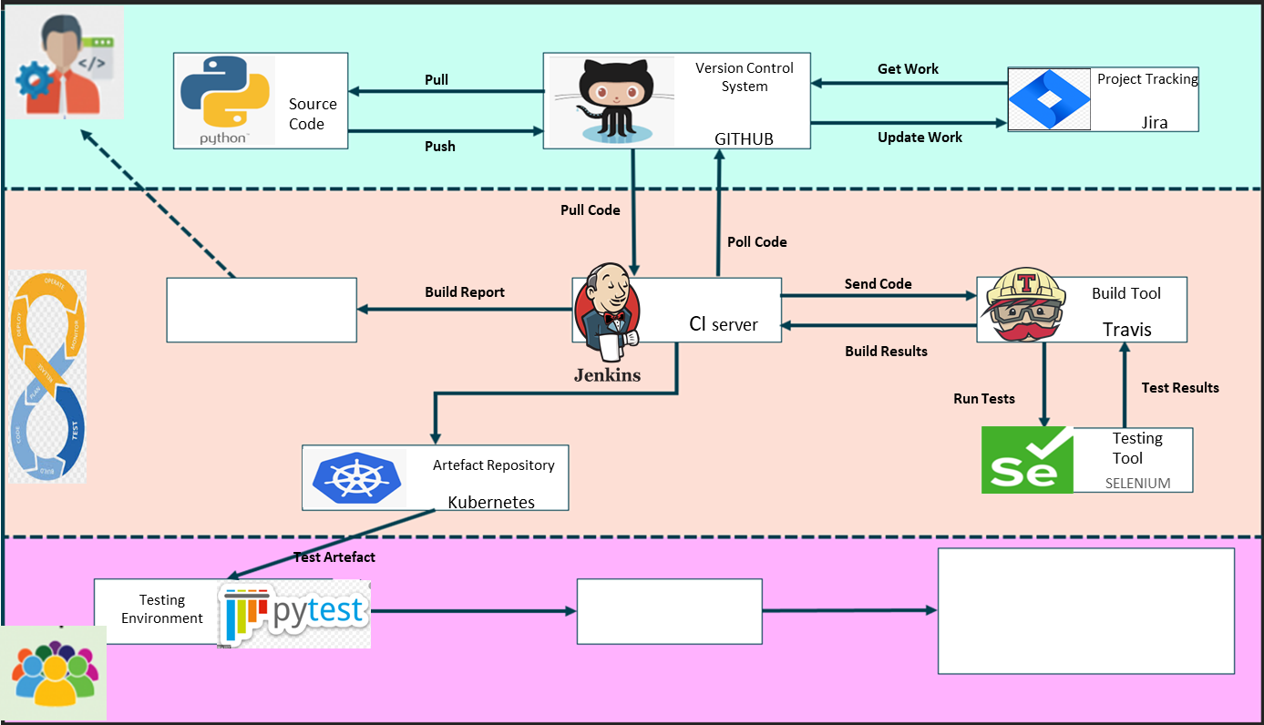
Developers
DEVOPS
Watch this space
Send Artefact
GitHub Repo
Watch this space
Coming Soon …….
Testers

